Slide 1
INTRODUCTION TO COMPUTERS

Slide 2
WHAT IS A COMPUTER?
Computer is an electronic device which accepts data as input and process the data as per given instructions then gives information as output.
Components:
Hardware: Physical parts of the computer : CPU, memory devices, input/output devices.
Software: Programs or applications that tell the hardware how to perform tasks.

Slide 3
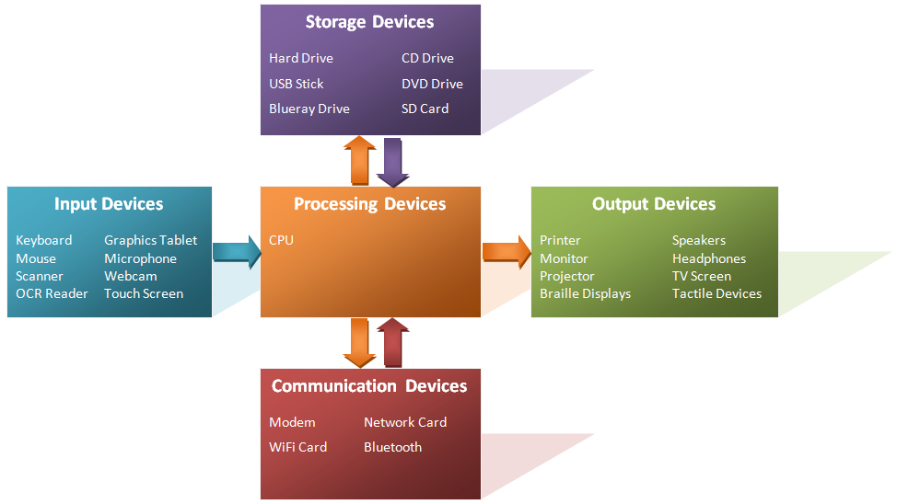

Slide 4
Characteristics:
Speed
Accuracy
automation
Versatility
Diligence
Reliability
storage and retrieval

Slide 5
Computer System
A computer system consists of :
Input Devices: Keyboard, mouse, scanner (to provide data to the computer).
Output Devices: Monitor, printer, speaker (to display or communicate results).
Processing Devices: CPU (Central Processing Unit) that executes instructions.
Storage Devices: Hard drives, SSDs, CDs, DVDs for storing data.

Slide 6
Types of Computers
Analog Computers: Handle continuous data (e.g., thermometers, speedometers).
Digital Computers: Process binary data (0s and 1s). Most common type used today.
Hybrid Computers: A mix of both analog and digital.

Slide 7
Generations of Computers
First Generation (1940-1956): Vacuum tubes for processing. (e.g., ENIAC, UNIVAC)
Second Generation (1956-1963): Transistors replace vacuum tubes.
Third Generation (1964-1971): Integrated Circuits (ICs) make computers smaller and more reliable.
Fourth Generation (1971-present): Microprocessors; personal computers and laptops.
Fifth Generation (Present and Beyond): Artificial intelligence and quantum computing.

